Slide 1

PANEL ARC- SEARCH ENGINE
Abhishek Dubey

Slide 2

Objective
In internet, a wide range of web information increases rapidly, user wants to retrieve the information based upon his preference of using search engines.
Our paper is going to propose a new type of search engine for web personalization approach.
Our approach is to improve the search accuracy by means of separating the concepts into content based concepts and location based which plays an important role in global search.
Moreover, recognizing the fact that different users and queries may have different emphasis on content and location information, we introduce the content and location based concepts and achieves their respective results.

Slide 3
Objective
All other search engine are taking into account "sort & look" rule, while PANEL ARC presents to you an all the more simple & intuitive "snap & discover" interface Additionally, you'll observe the site to be a considerable measure more pictorial in interface than some other web crawlers in this way.

Slide 4

Importance
Search engine traffic is one of the most valuable sources of traffic, if not the most valuable. An internet user conducting a search has a specific intent. They are looking for something in particular. The website brings the near future today by taking a step ahead of present day search engines.
Panel Arc provides you:-
Better Interface - In other search engine you have to Type then Search. But in PANEL ARC you have to Click then Search. In PANEL ARC all the things are pre-defined. All the things are given. We have a panel of all the data separately. Each data has his own section. You can find the things easily.

Slide 5
Easily Accessible - Each day almost 5-6 billion people join the internet, they are new to the internet. They don’t know How to use it. Which sites are useful for them? Which sites provide education? From which site they have download the data. And many more.... Google is too vast. It is difficult to find these information by new comer. PANEL ARC is the compress form of all other search engines. This is a type of META SEARCH ENGINE.
Panels for online and offline streaming - Now a day there is problem of online TV. You have to go to different TV for different program which is difficult to remember. It has its own movie panel. From where you can download movies free without visiting other sites. All kinds of movie are there in one panel. In PANEL ARC there is a separate panel for online TV, Movies, Game, and music. All the channels are here. No need to roam on other search engine. Just go through PANEL ARC.

Slide 6
Methodology
PANEL ARC is a website cum search engine pivoting to take a step forward of big brand search engines. Here, you find everything that you need from watching movies lounging in your room to travelling round the globe, shopping, socializing, entertainment, food, music, news, videos, software’s, education, jobs, live streaming, English & Hindi TV shows, sports, comedy, PC games and also a custom search box is just a few clicks away from you. Also you can effectuate your conventional Google search on the website.
The basic requirement to build a search engine is knowledge and skill. A search engine fundamentally needs to accept some sort of search query (for instance, a series of words) and then return web resources that it thinks are appropriate to the query. The way it decides what is appropriate to the query can be very important. One can use a simple algorithm like counting how many times any of the search words appears on a page.

Slide 7
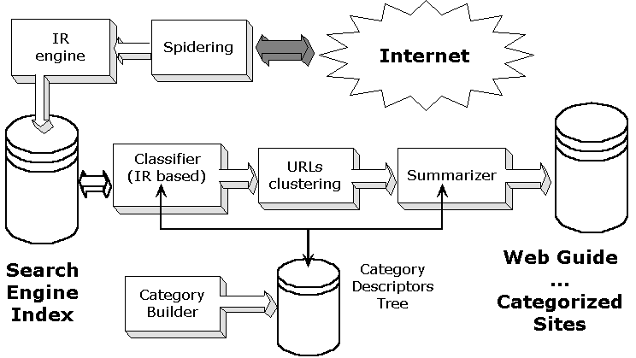
Architecture

Slide 8
Future Scope
Search engines have slowly evolved from performing merely keyword based searches to intelligent knowledge engines. The future of search engine is still uncertain, but it is surely going to impact many aspects of our daily life. The website provides a new way to search and find the desired content. PANEL ARC is a website cum search engine pivoting to take a step forward of big brand search engines. Here, you find everything that you need from watching movies lounging in your room to travelling round the globe, shopping, socializing, entertainment, food, music, news, videos, software’s, education, jobs, live streaming, English & Hindi TV shows, sports, comedy, PC games and also a custom search box is just a few clicks away from you.

